Slide 1

Digital Logic Design

Slide 2
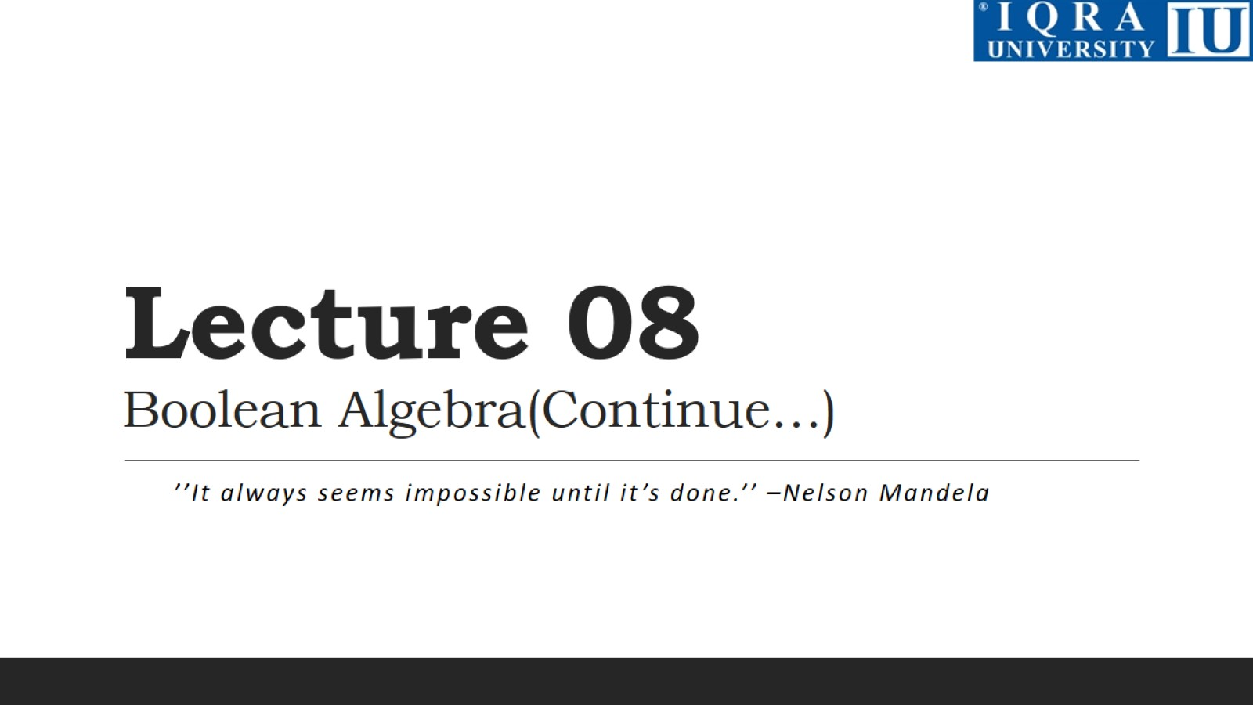
Lecture 08 Boolean Algebra(Continue…)

Slide 3
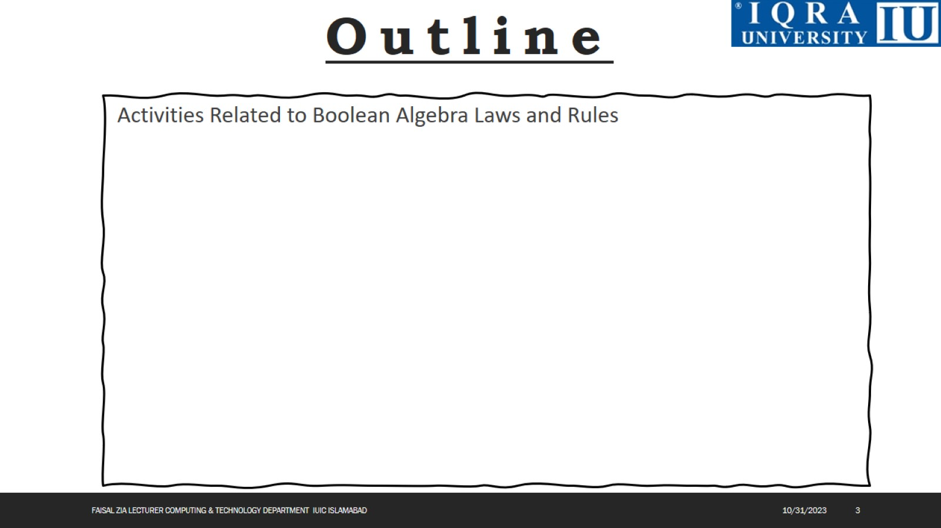

Slide 4
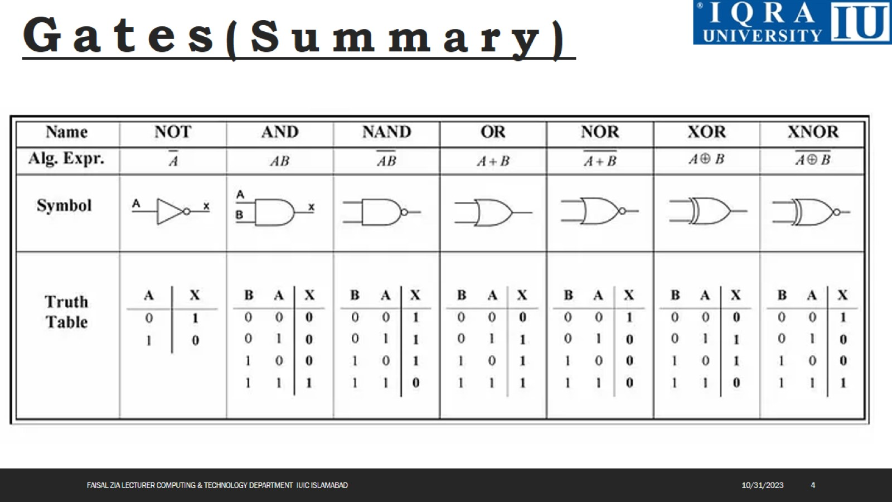

Slide 5
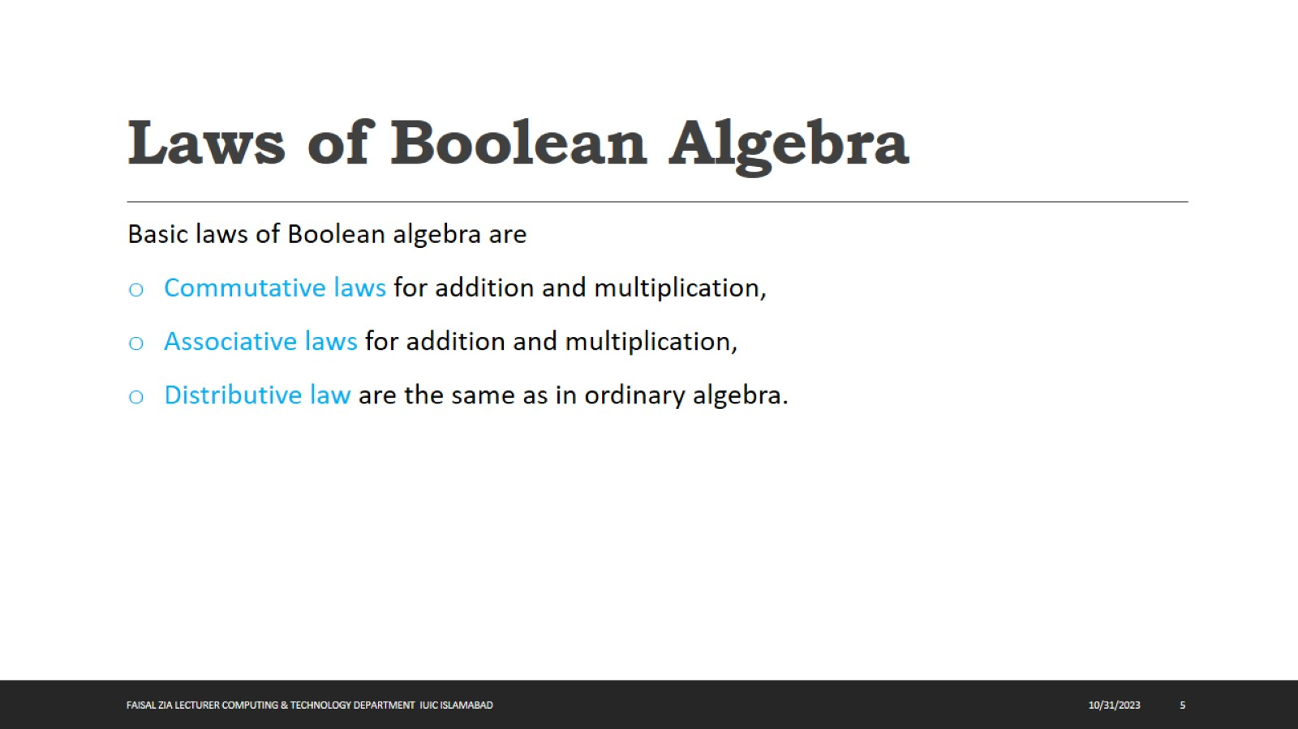
Laws of Boolean Algebra

Slide 6
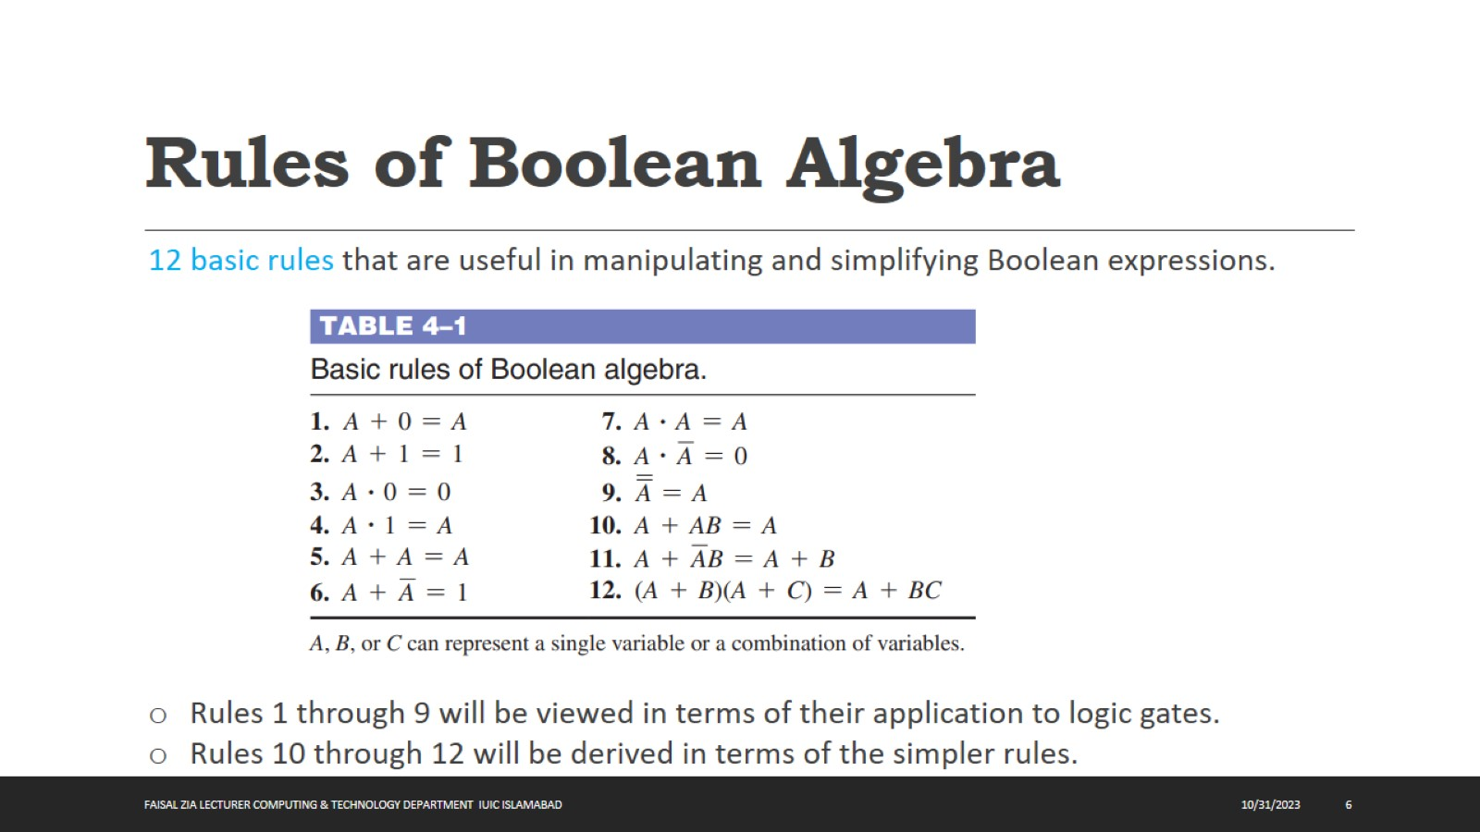
Rules of Boolean Algebra

Slide 7
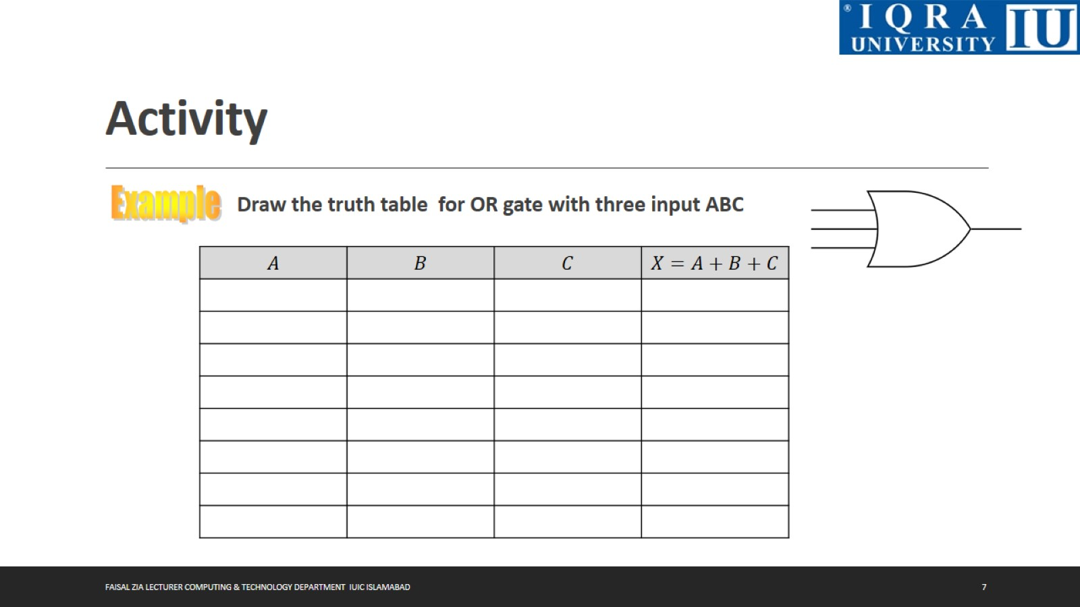
Activity

Slide 8

Activity

Slide 9
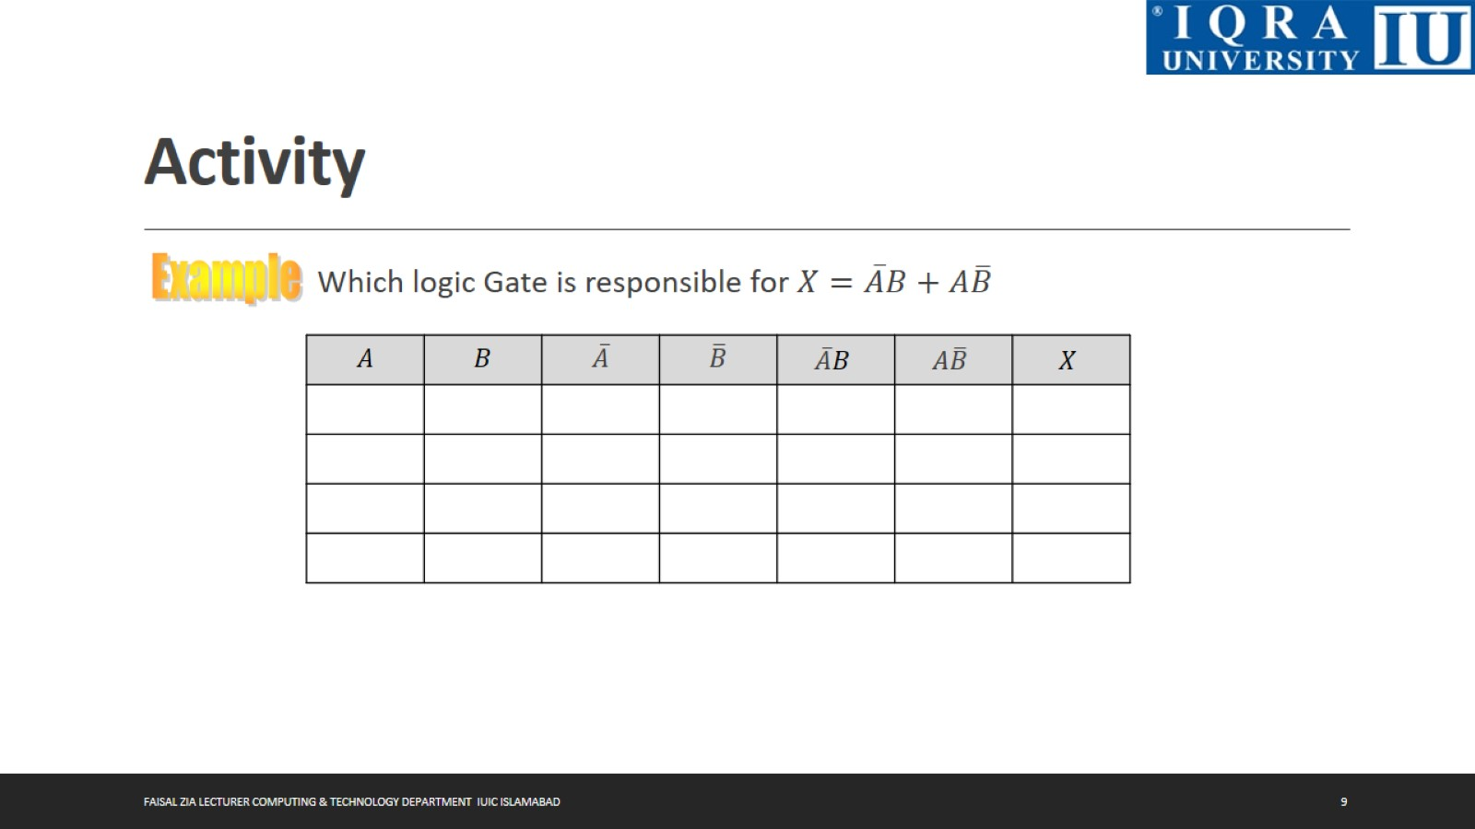
Activity

Slide 10
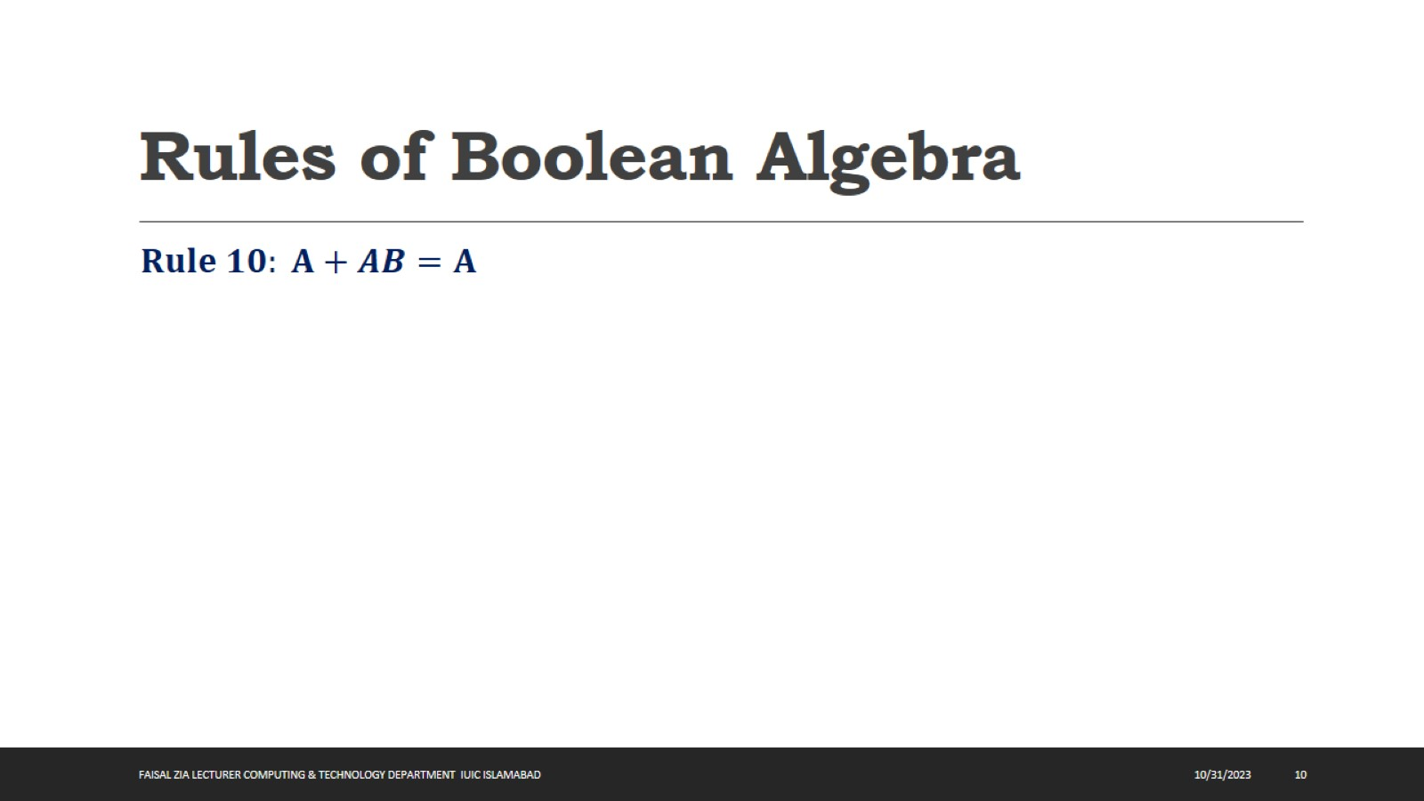
Rules of Boolean Algebra

Slide 11
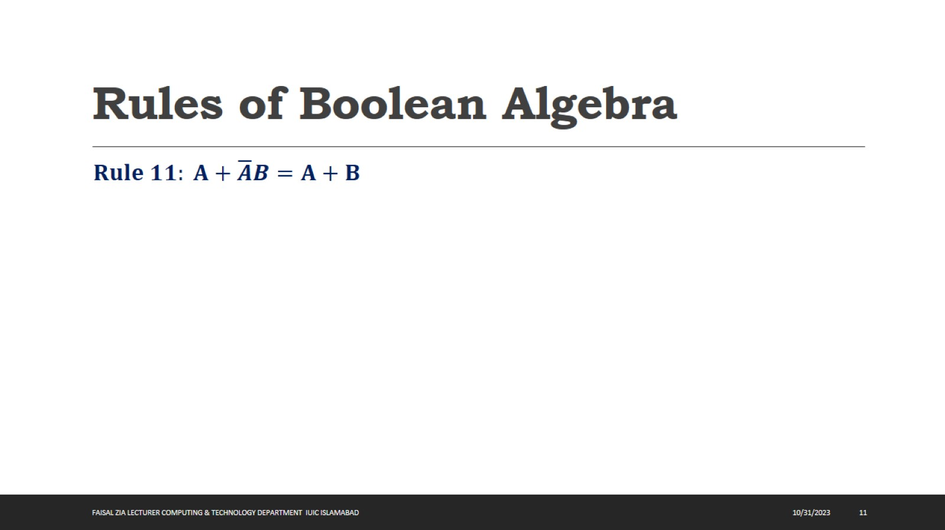
Rules of Boolean Algebra

Slide 12
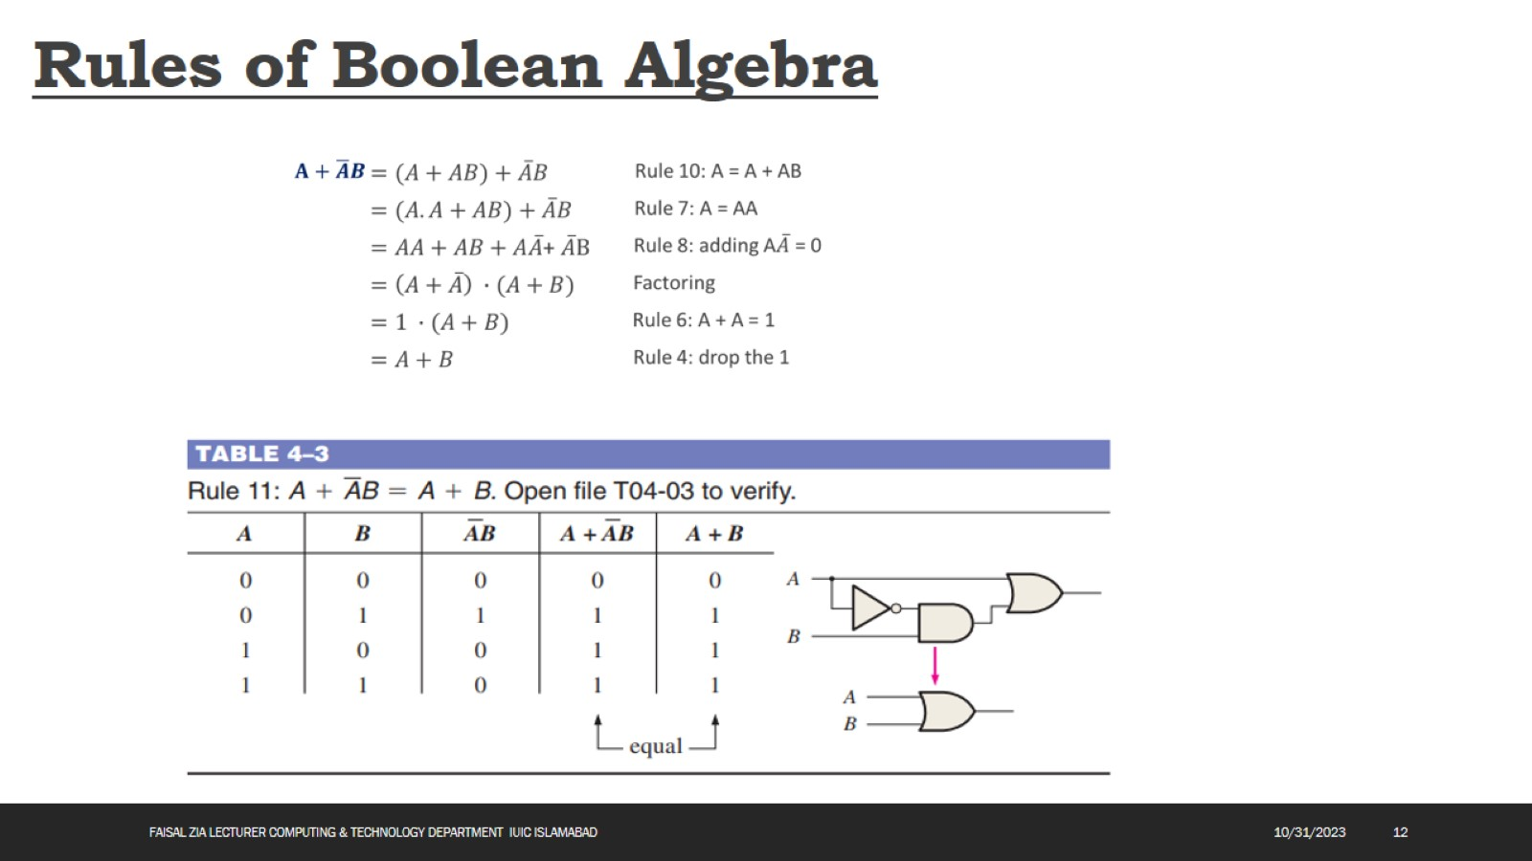
Rules of Boolean Algebra

Slide 13
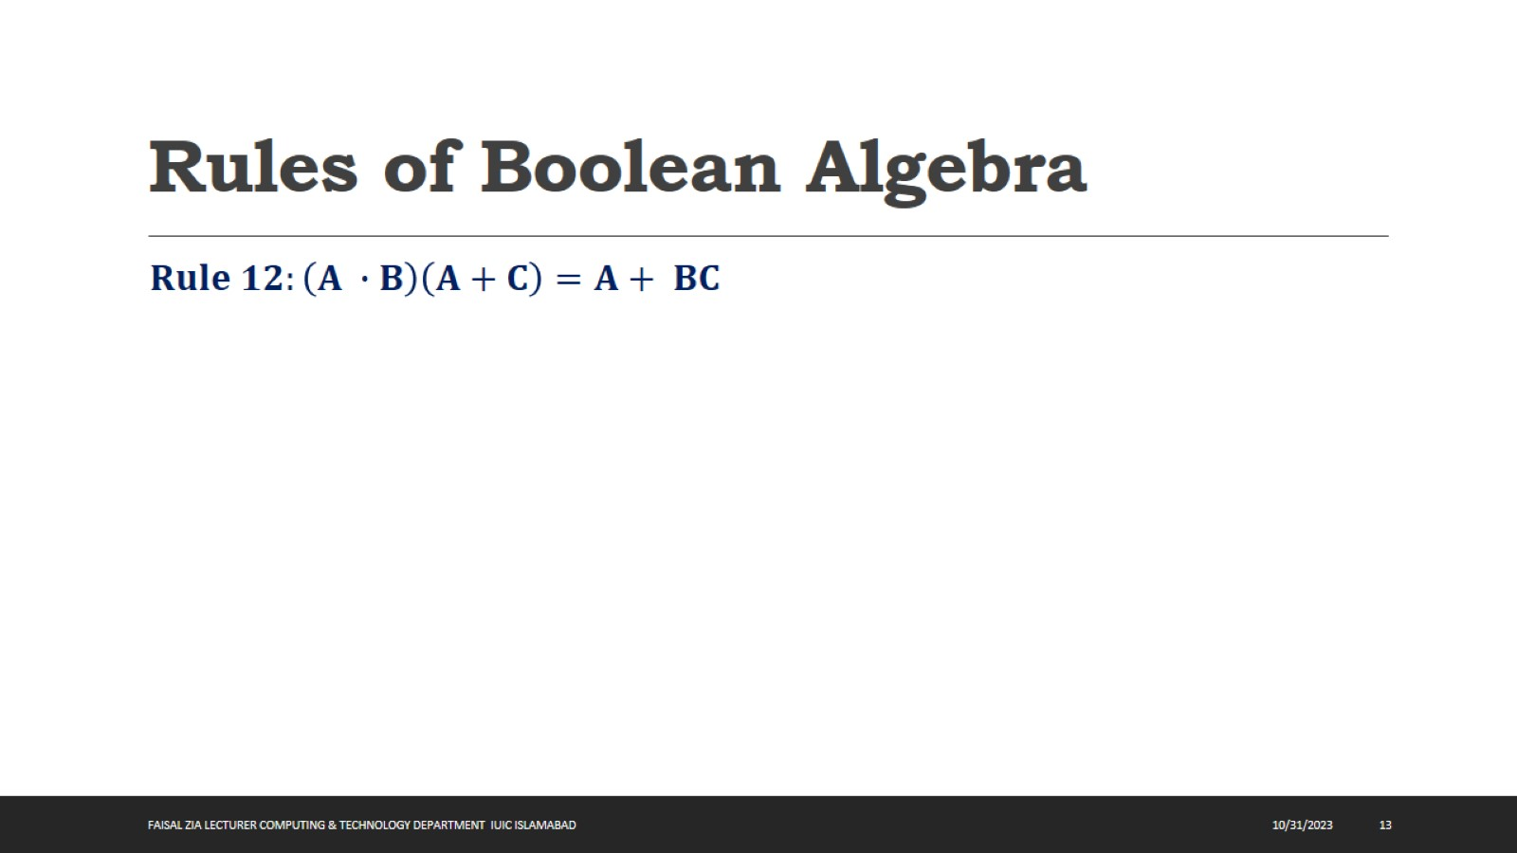
Rules of Boolean Algebra

Slide 14
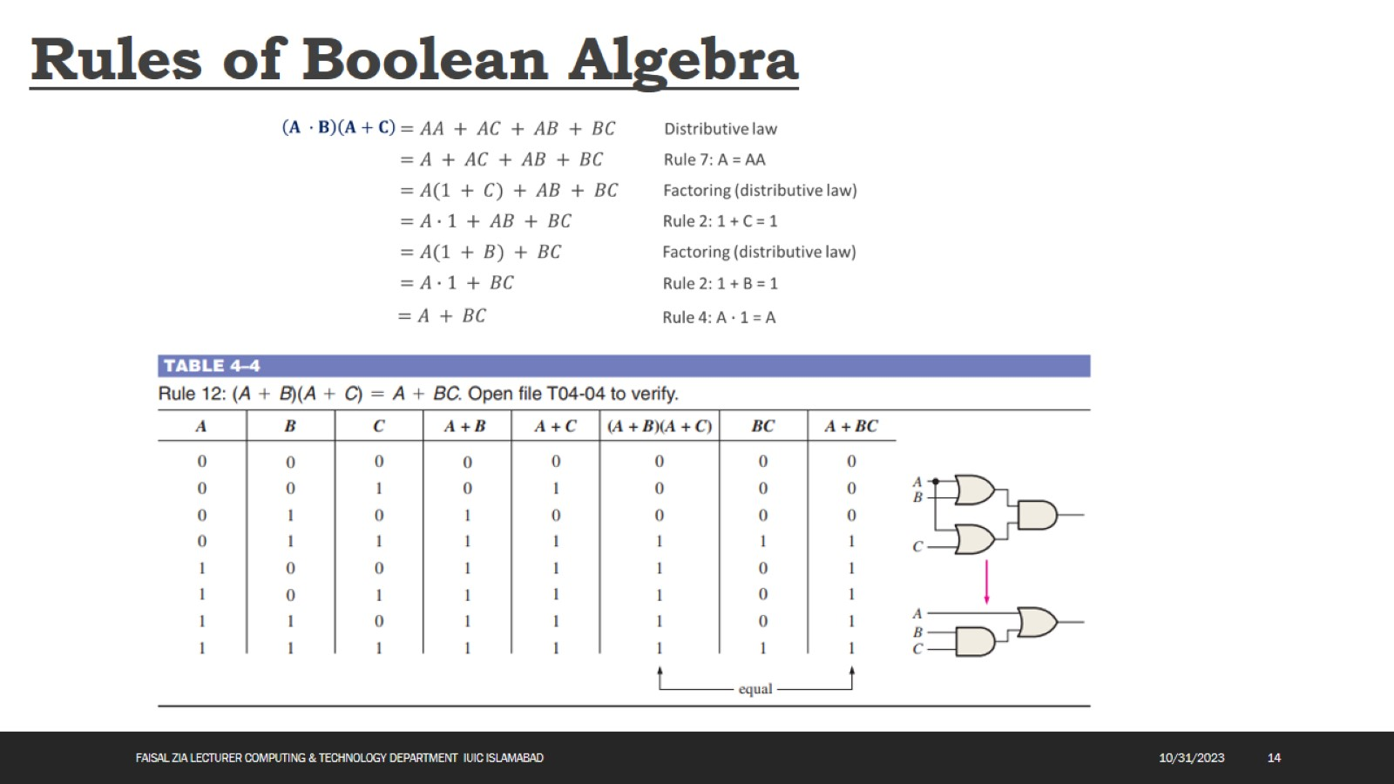
Rules of Boolean Algebra

Slide 15
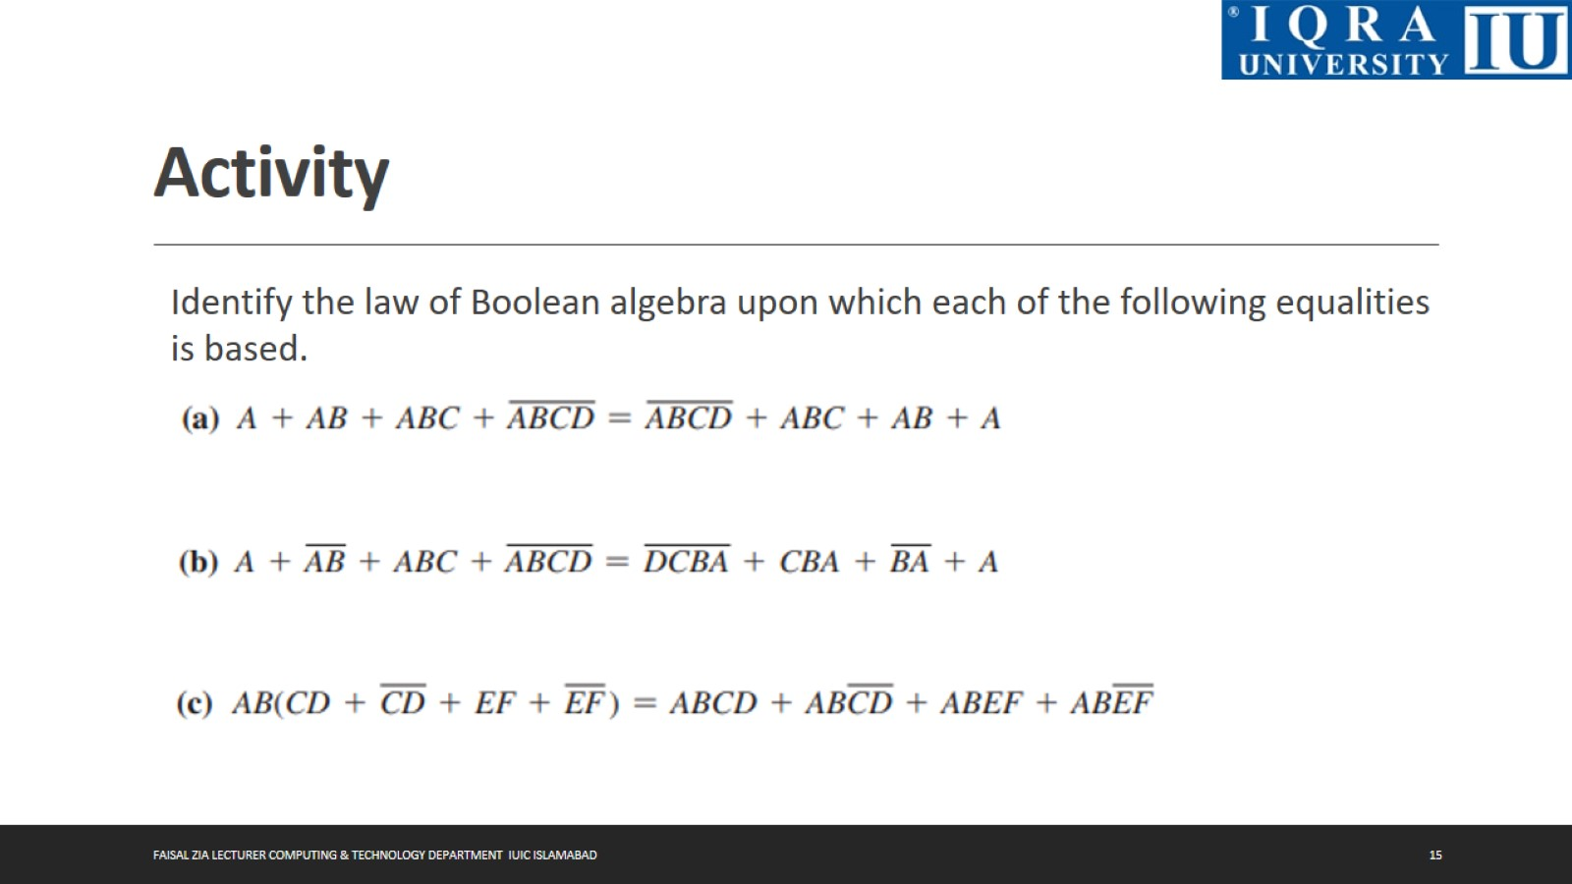
Activity

Slide 16

Activity

Slide 17

Activity

Slide 18
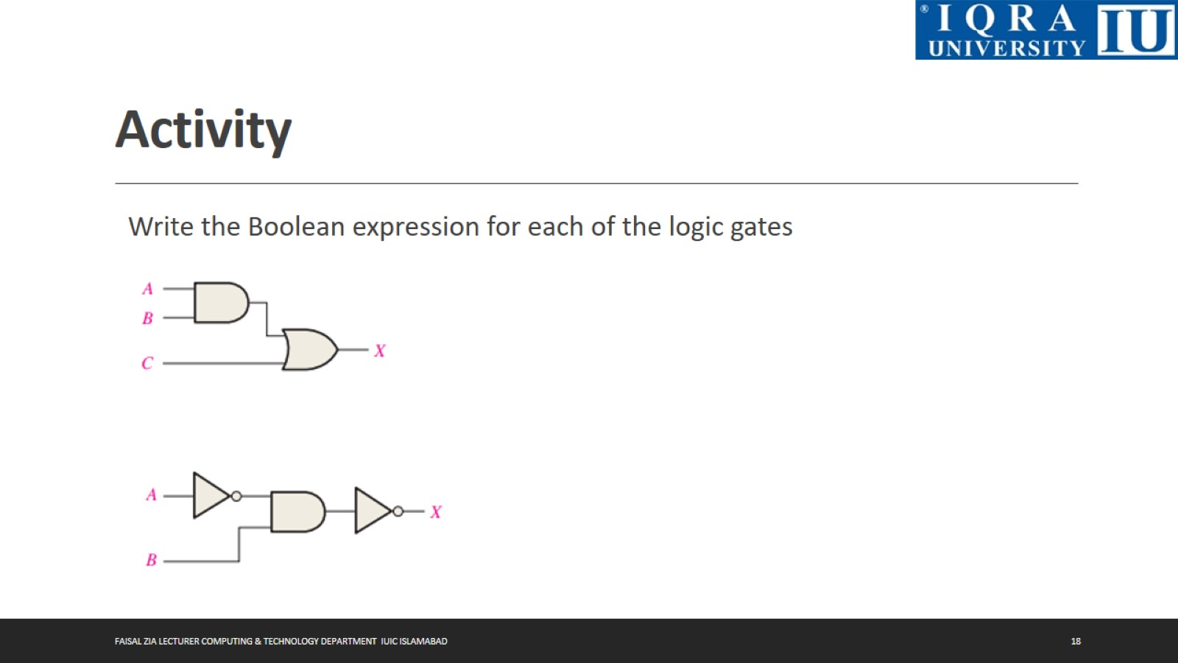
Activity

Slide 19
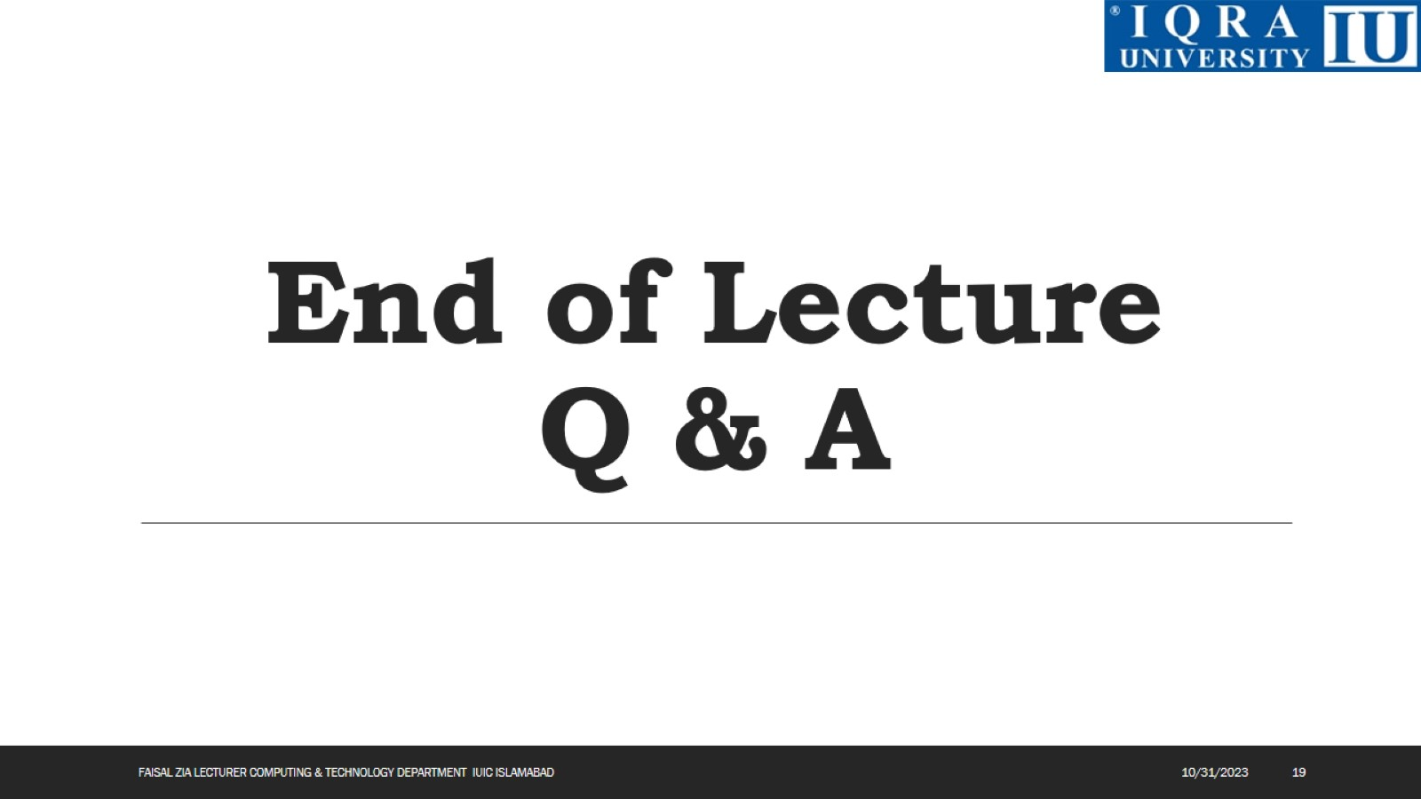
End of Lecture Q & A

